Slide 1
Packs of Attacks: Trends in Iraqi Terrorism Kevin Liu Huang

Slide 2
Background (1 of 2)
One of the hardest yet most important things for any deployed military servicemember to do is to learn from the enemy’s past behavior in order to predict and prevent future attacks.
It is rare for such data to be made publicly available, due to the highly sensitive nature of security information.
There was an exception in October 2010, when WikiLeaks published the largest classified military leak in history, called the Iraq War Logs.

Slide 3
Background (2 of 2)
After significant data cleaning and censorship of the most sensitive data files, the Guardian published a subset of the Iraq War Logs containing significant actions (SIGACTs) during the war from Jan 1, 2004 to Dec 31, 2009. Each line of the data consists of the following data:
Report_ID
Unique identifier for each SIGACT
civ_cas
Total civilian casualties (wounded and killed)
Date
Year, month, day
coal_cas
Total coalition casualties (wounded and killed)
Incident_Type
Type of enemy action (total of 20 types of events)
Iraqi_cas
Total Iraqi Army casualties (wounded and killed)
Latitude
Latitude according to WGS 1984 projection
enem_cas
Total terrorist enemy casualties (wounded, killed, or detained)
Longitude
Longitude

Slide 4
Project Goals
Key Question: What can past terror attacks tell us about the nature of future terror attacks?
Do SIGACT casualties reveal any trends in the precision of military action (aka, only killing enemies and not civilians)?
Can knowing the locations of previous attacks provide intel about where terror groups may be residing?

Slide 5
Overall View of Data
Scope of SIGACTS regression:
Activity in which there is at least one civilian casualty AND one enemy casualty (to exclude precision-agnostic events)
All incident types included
Why Regression:
Informs us if number of civilian casualties can be predicted based on number of enemy, coalition, or Iraqi casualties
Implies level of discretion on behalf of terrorists/coalition forces for avoiding civilian casualties
However, non-causal in nature

Slide 6
Regressions on Civilian Casualties
Civilian Casualties
Enemy Casualties
Coalition Casualties
Iraqi Army Casualties

Slide 7
Results of Linear Regression
Civilian casualties ~ Coalition casualties + Enemy Casualties + Iraqi casualties
Not significant
(Coef: 0.3046)
Not significant (Coef: 0.0022)
Significant (Coef: 0.6243)
Conclusion: Terror attacks that result in Iraqi soldiers casualties are also likely to result in civilian casualties. For every Iraqi soldier casualty, there is likely to be 0.6243 civilian casualties in the same event.
However, relationship is relatively weak (only 1.4% of all variation can be explained by this data.

Slide 8
Results of Linear Regression
Civilian casualties ~ Coalition casualties + Enemy Casualties^3 + Iraqi casualties
Not significant
(Coef: 0.4953)
Significant (Coef: 0.0021)
Significant (Coef: 0.6257)
Conclusion: Terror attacks that result in Iraqi soldiers casualties and, to a lesser extent, enemy casualties are also likely to result in civilian casualties.
However, relationship is only slightly improved (only 1.5% of all variation can be explained by this data.

Slide 9
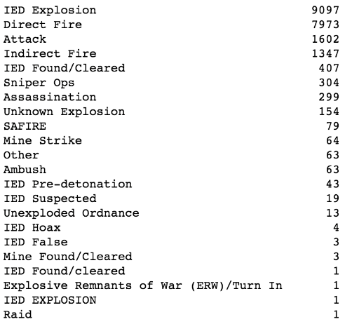
Analysis of Most Frequent SIGACTS
Distribution of SIGACTS
Scope of SIGACTS cluster analysis:
Top 4 types of SIGACTS
All time periods are included
Method:
K Nearest Neighbors (essentially minimizing distance between cluster centers and SIGACTs)
Has the power to inform us where the geographic center of violent terror activity is
Cluster based solely on location will not require scaling
Conducted for each type of SIGACT can inform us if particular enemy tactics have unique epicenters

Slide 10
Geographic Distribution of SIGACTS
IED Explosions
Direct Fire
Attacks
Indirect Fire
n = 9,097
n = 7,973
n = 1,602
n = 1,347
21,541

Slide 11
Optimized Number of Clusters
IED Explosions
Direct Fire
Attacks
IDF

Slide 12
Locations of Clusters
IED Explosions
Direct Fire
Attacks
IDF

Slide 13
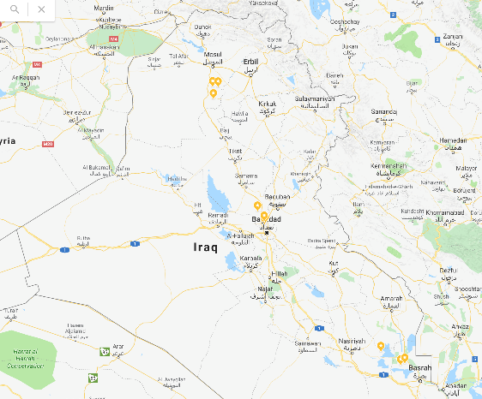
Likely Epicenters of Enemy Activity
While conventional enemy activity (IEDs, direct fire, and attacks) originate from all 3 clusters, indirect fire (which requires artillery assets that are harder to acquire or mobilize) is only clustered around the top 2 clusters and is not located in vicinity of Basrah.
IVO of Mosul
IVO of Baghdad
IVO of Basrah

Slide 14
Conclusions
At this time, it is hard to conclude a predictive relationship between various enemy, coalition, and Iraqi Army casualties with civilian casualties. While significant predictors exist in Iraqi Army and enemy casualties, they have very low explanatory power and describe a loose association.
Cluster analysis reveals three geographic cluster spots from which enemy attacks likely originate, with two of them specifically geared towards indirect fire. This speaks to the likely distribution of enemy locations.

Slide 15
Next Steps
Add in additional measure for how urban vs rural each environment is in which an attack is conducted.
Add in variables for dominant religious sect for each SIGACT.
Replicate analysis with cross-sections of the data, perhaps by time (predicting future months with single months’ worth of data).
Replicate analysis with Afghanistan War Logs.

Slide 16
Acknowledgements & Citations
Special thanks to Sri Kanajan and Ed Lee of General Assembly.
Iraq War Diary files provided by The Guardian in 2010, originally sourced from WikiLeaks (redacted).

